Slide 1

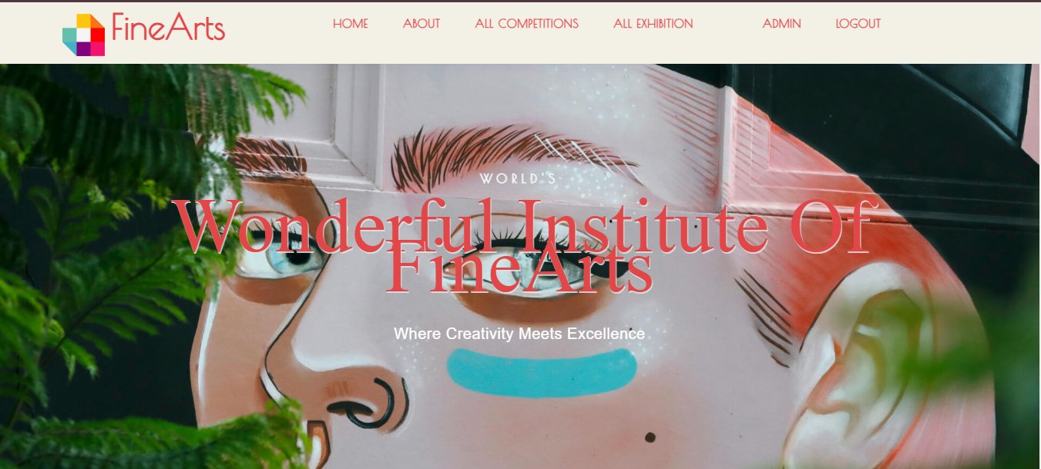

FINE ARTS INSTITUTE
Fine Arts Institute Management System

Slide 2
Introduction
What is this Project?
A website for managing competitions, awards, and submissions at the Fine Arts Institute.
Why this Project?
To make it easier for students, staff, and managers to work.

Slide 3

User Roles in the Website
The website includes 4 types of users:
Manager:
Oversees the system and tracks overall activities.
Administrator:
Manages staff and student records.
Staff (Teacher):
Organizes competitions and evaluates student work.
Student:
Participates in competitions and uploads their creative designs.

Slide 4
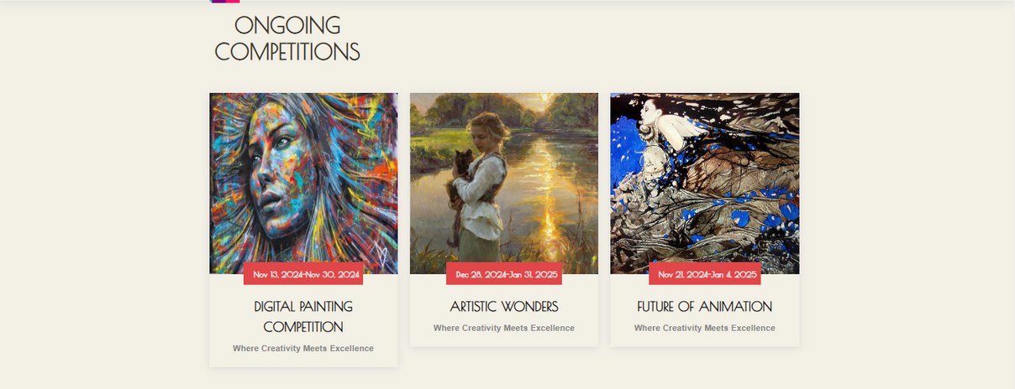
Home Page Features
Upcoming Competitions:
The home page displays information about all competitions that are planned to happen soon.
Ongoing Competitions:
Users can view details of competitions that are currently active.
Awarded Students:
A list of students who won awards in previous competitions is shown.

Slide 5

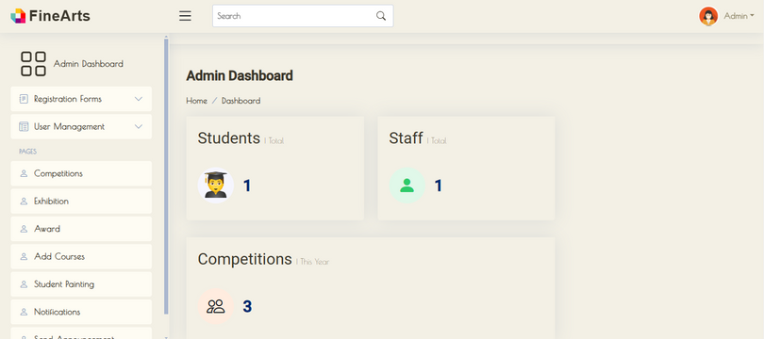
Manage Staff:
Add, edit, delete, and view staff details (login, work, and personal information).
01
02
Manage Students:
Add, edit, delete, and view student details (admission and login info).
Administrator Role
03
Manage Competitions:
Add, edit, delete, and view competition details.
04
Manage Exhibitions:
Add, edit, delete, and view exhibition details.
Manage Awards:
Add, edit, delete, and view award details for competitions.
05

Slide 6
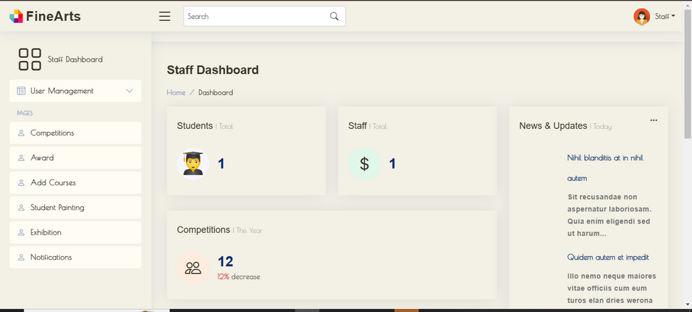
View Student Details:
Access student information, including personal and admission details.
01
02
Manage Competitions:
Set start and end dates, define awards, and manage competition details.
Staff Role
03
Review Student Submissions:
Mark submissions as Best, Good, or Disqualified based on their creativity.
04
Manage Awards:
Assign awards to students based on competition results.
Send Designs to Exhibitions:
Select and forward the best student designs to exhibitions.
05

Slide 7

View Competition Details:
See upcoming competitions, awards, and conditions.
01
02
Upload Designs:
Submit their designs along with poems or stories.
Student Role
03
Edit Submissions:
Modify their submissions before the competition deadline.
04
Check Results & Feedback:
View staff feedback and the status of their submissions.
View Paintings in Exhibitions:
Check if their artwork is displayed, its sold status, and the price.
05

Slide 8
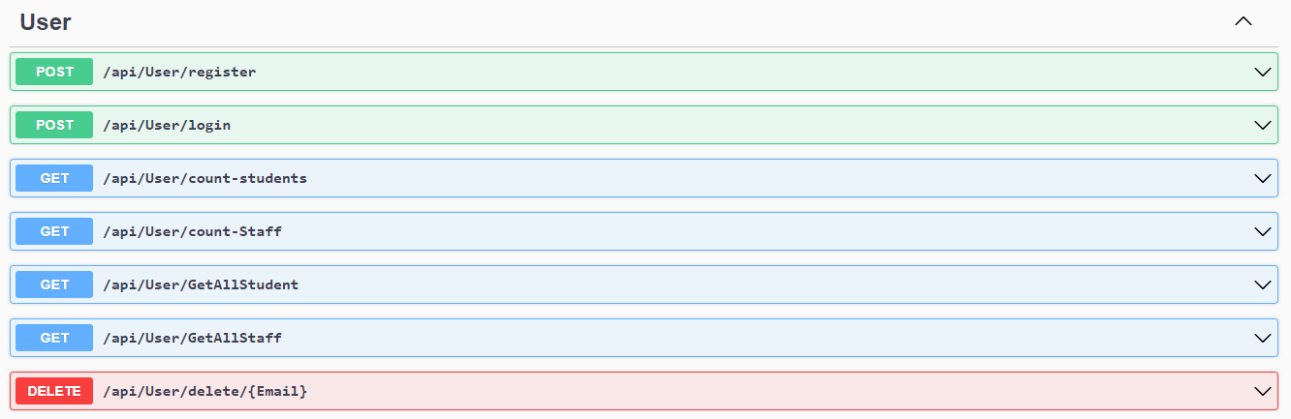
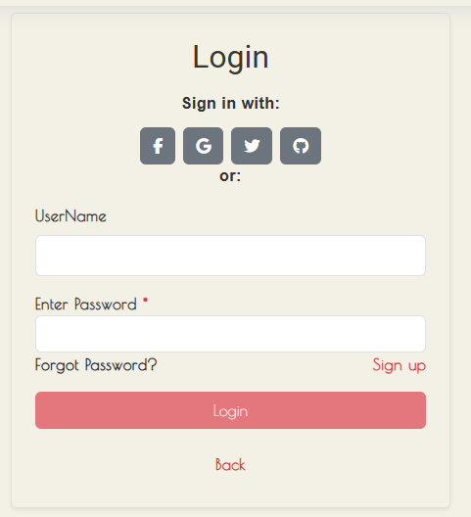
Backend: .NET Core API
Frontend: Angular
Database: Microsoft SQL Server

Slide 9
Backend: .NET Core API
Used to build secure and scalable server-side functionality.
Frontend: Angular
A framework for creating dynamic and responsive user interfaces.
Database: Microsoft SQL Server
Stores and manages all data securely for the application.
Our services

Slide 10
Benefits of the Fine Arts Institute Website
Easy Competition Management
Organize competitions with clear deadlines and awards.
Better Student Participation
Students can submit work, get feedback, and win awards.
Simple Data Management
Store and manage staff and student details in one place.
Showcase Talent
Display student work in exhibitions and track sales.
Role-Based Access
Different features for managers, staff, students, and admins.
Clear Feedback System
Students get helpful feedback to improve their skills.
CEO & Founder
Project manager
IT Expert
Marketing Head

Slide 11



THANK YOU!

Slide 12



TOOLS USED

